Slide 1

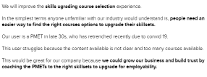
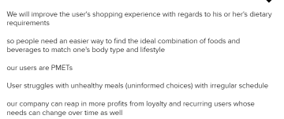

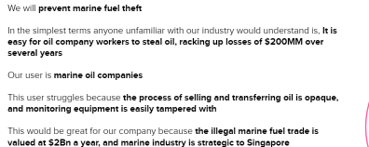

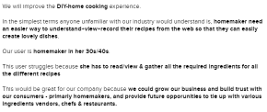
Ideas of Business Opportunity

Slide 2
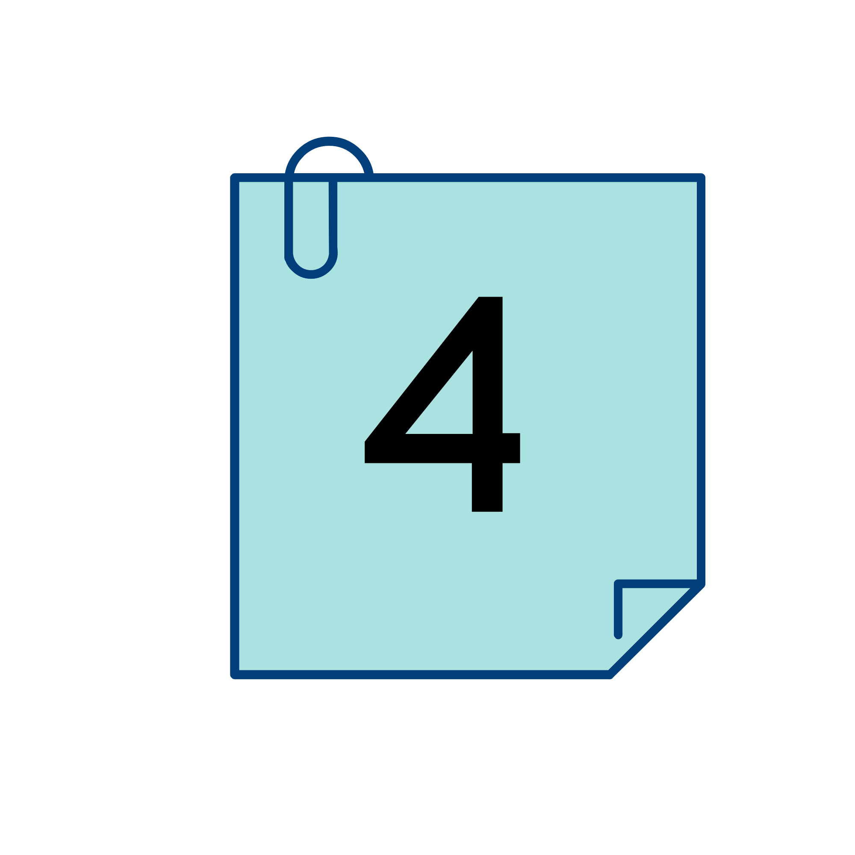

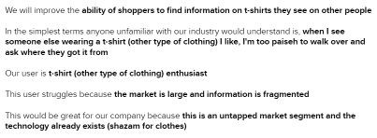
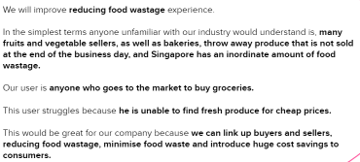


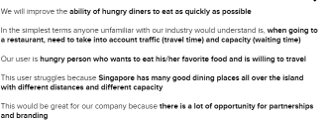
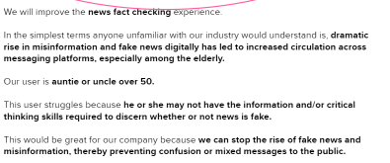

Slide 3
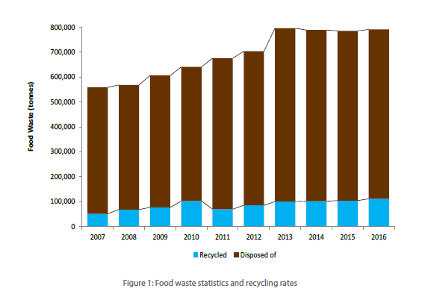
Challenge of food waste in Singapore
1. Over 10 years, food waste has increased by about 40%
2. More can done to minimize food waste, and ensure that
food resources are utlilised in a more efficient manner.
3. Reducing food waste can help lessen the demand on
food supply, thereby enhancing food security in Singapore.
Notes:
For example, in 2016, 791,000 tonnes of food waste generated in Singapore, accounting for 10% of the the total waste generated. Yet, only 14% of the food waste generated was recycled; the rest of the food waste was disposed of at wasteo energy plants.

Slide 4
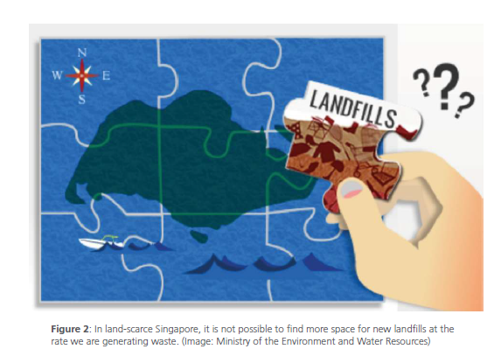
Why Should Business Care
1.Economics
- Savings on material cost and disposal fees that increase in profits
2. Social
- Helping the low income households in securing adequate food supply
3. Environment
- Due to Singapore being land-scarce, it is not sustainable to allow food waste to grow uncurbed.
Notes:
Economics
- Identifying the sources of food waste can uncover inefficiencies in the supply chain, such as the
wastage of raw materials. For businesses, it makes economic sense to reduce wastage of raw
materials that are bought. Apart from material cost savings, companies also save on disposal
fees. These ultimately translate to an increase in profits.
Social
In Singapore, there are about 105,000 households earning below $1,500 a month1. Some of
these households may face difficulties in securing adequate food supply. Thus, in improving our
practices and attitudes towards food production and waste management, supermarket operators
can also consider the donation of surplus or unconsumed food to help those in need.
ENVIRONMENT
When food goes to waste, so do all of the resources (e.g. energy and water) that were used to
produce it, making the environmental implications of wasted food more significant.
In addition, food waste disposed of is incinerated with general waste and the ashes produced
are sent to our only offshore landfill. Due to Singapore being land-scarce, it is not sustainable to
allow food waste to grow uncurbed. If overall waste continues to increase at our current rate,
Singapore will need a new landfill every 30-35 years.

Slide 5
Business Statement Opportunity

Slide 6
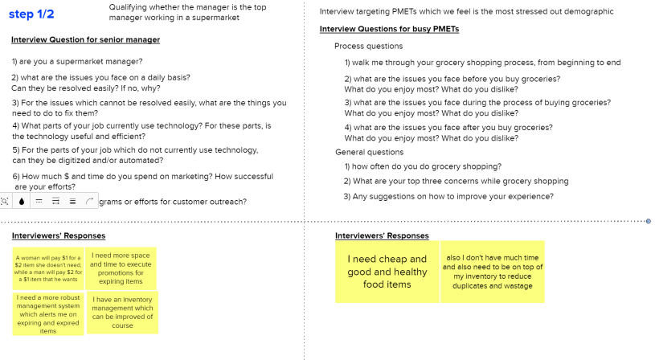
Interview

Slide 7
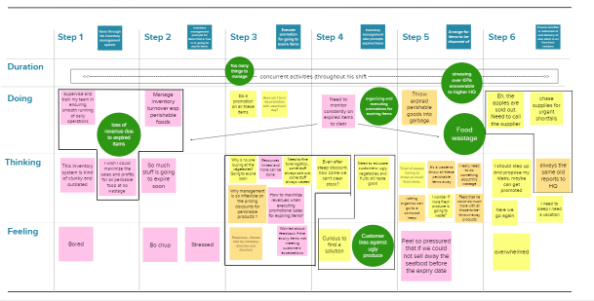

Alvin’s Current Experience

Slide 8
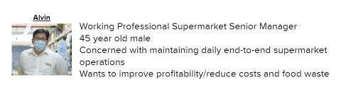
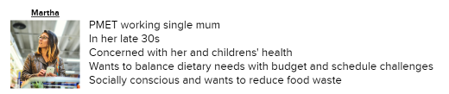
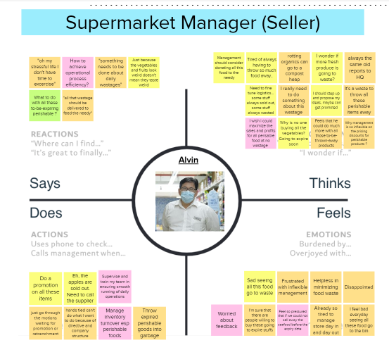
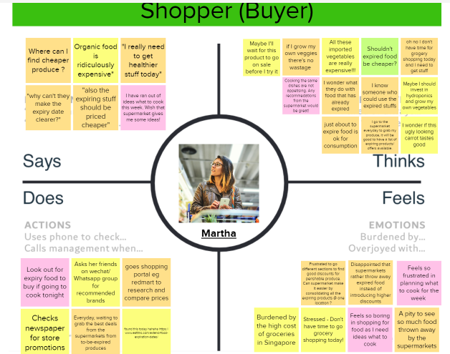
Target User Empathy Map

Slide 9
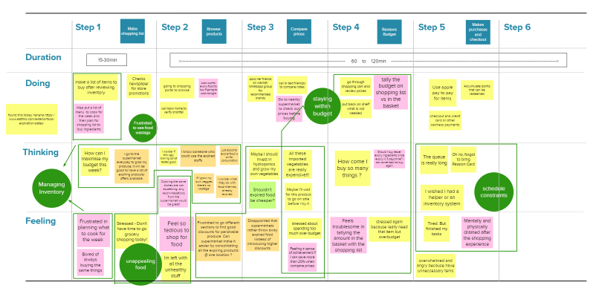

Martha’s Current Experience

Slide 10
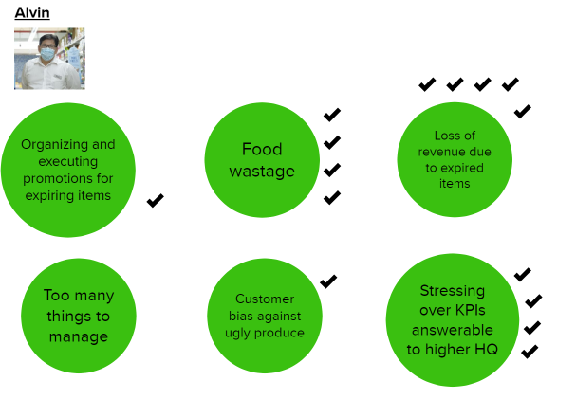
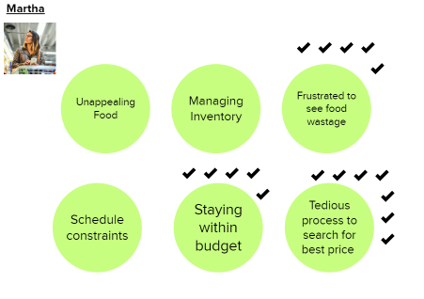
Prioritize Pain Points

Slide 11
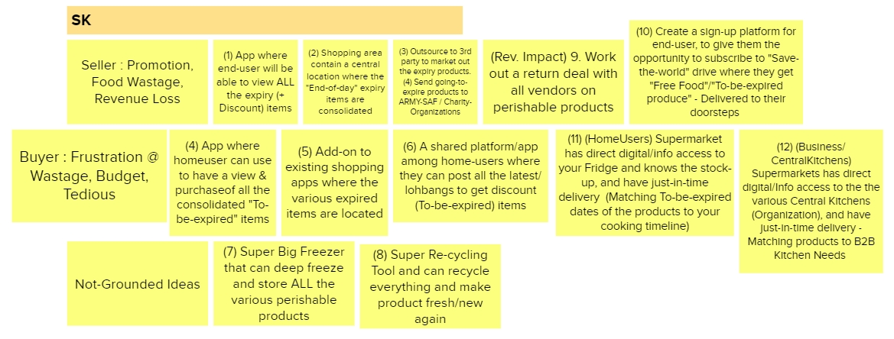
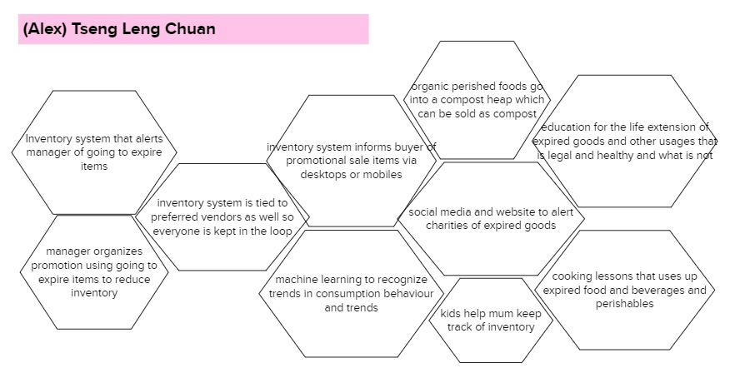
Big Ideas1

Slide 12
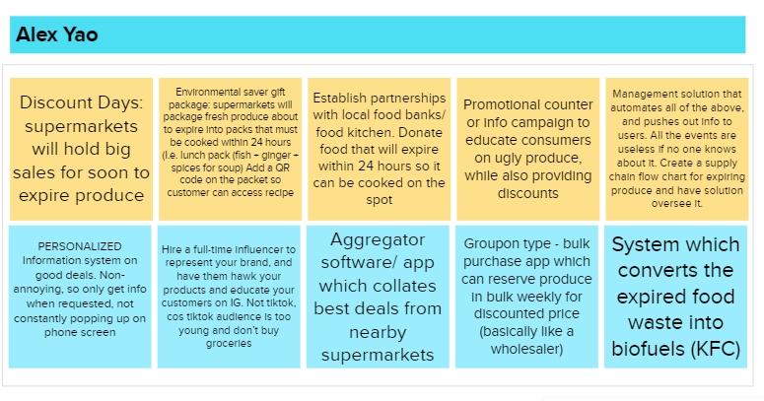
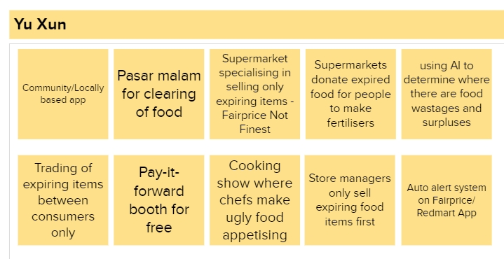
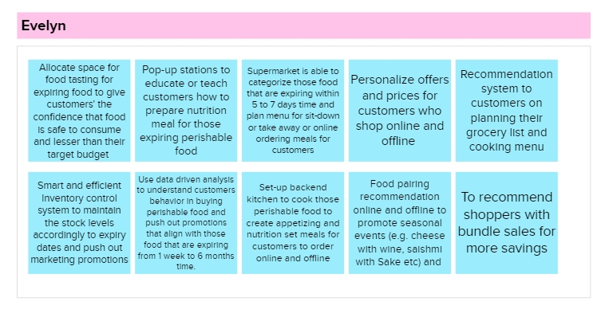
Big Ideas 2

Slide 13
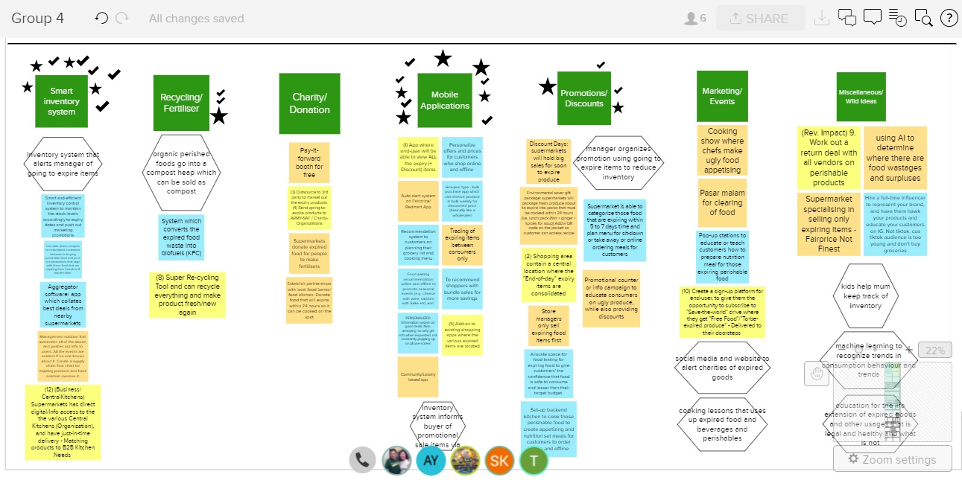
Categorizing and Voting of Big Ideas

Slide 14
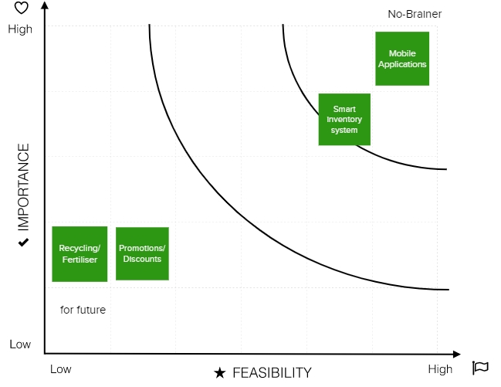
Idea Prioritization Grid
We decided on a smart inventory system on a mobile app

Slide 15
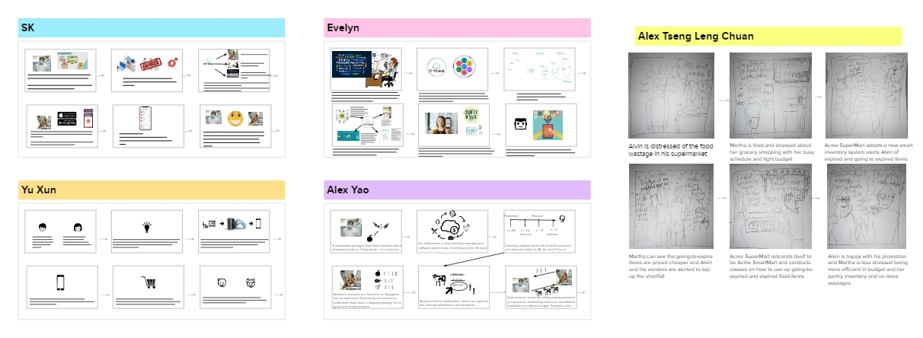
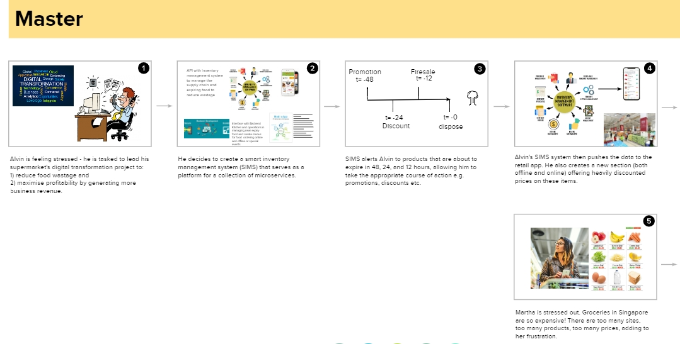
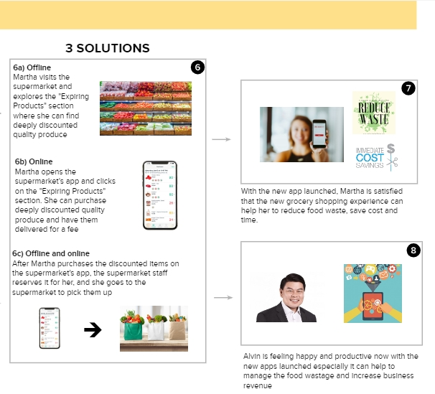
Storyboards and Master Storyboards

Slide 16
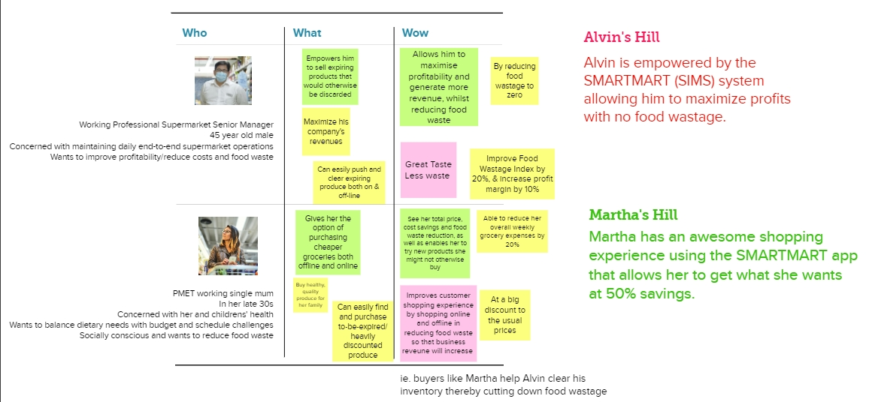
Hill Statements

